Slide 1
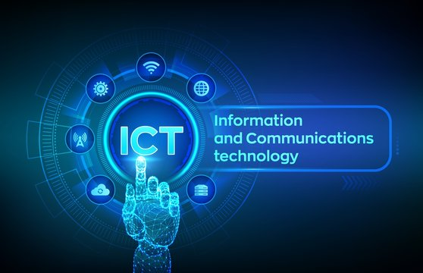
IMPACT OF INFORMATION AND COMMUNICATION TECHNOLOGY (ICT) IN BANKING

Slide 2
INTRODUCTION
ICT has taken the center stage in almost every aspect of human endeavor. ICT help banks improve the efficiency and effectiveness of services offered to customers, and enhances business processes, managerial decision making, and workgroup collaborations, which strengthens their competitive positions in rapidly changing and emerging economies. This project considers the impacts and trends of ICTs on the banking industry of the 21st century.

Slide 3
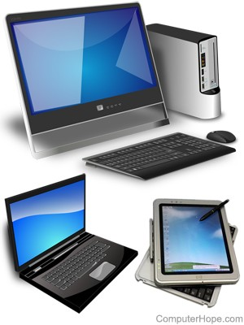
WHAT IS A COMPUTER?
A computer is a digital electronic machine that can be programmed to carry out sequences of arithmetic or logical operations (Computation) automatically. Modern computers can perform generic sets of operations known as programs. These programs enable computer to perform a wide range of tasks. A computer system is a “complete” computer that includes the hardware, operating system (main software), and peripheral equipment needed and used for “full” operation.

Slide 4
BRIEF HISTORY OF COMPUTER
The history of computer began, at the birth of Abacus (A machine with string and beads used for counting), named after Abacus. Early computers were meant to be used only for calculations. The first digital calculator which could perform some arithmetic operations like subtraction and addition was invented by Blaise Pascal.
Later on in 1671, Gottfried Wilhelm Von Leibnitz invented a small computer, not the advanced technological ones that can add and multiply. Soon after, Charles Xavier Thomas built a more advance calculator or computer that can subtract, add and multiply. Later on, Charles Babbage, an English mechanical engineer and polymath, originated the concept programmable computer, and this made him to be considered as “the father of computer”.

Slide 5
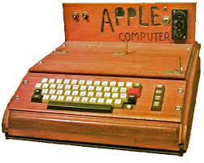
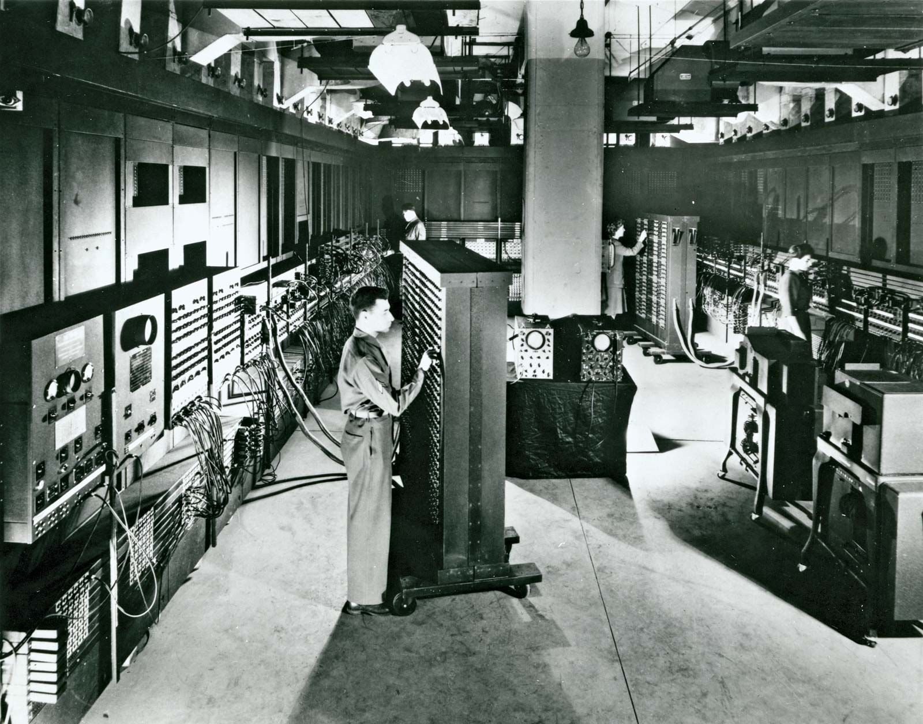
IMAGES OF FIRST COMPUTERS
FIRST APPLE COMPUTER
FIRST DIGITAL COMPUTER (ENIAC)

Slide 6
BRIEF HISTORY OF BANKING
The history of banking began with the first prototype banks which were the merchants of the world, who gave grain loans to farmers and traders who carried goods between cities. This was around 2000 BCE in Assyria, India and Sumeria. Later, in ancient Greece and during the Roman Empire, lenders based in temples gave loans, while accepting deposits and performing the change of money. Archaeology from this period in ancient China and India also shows evidence of money lending. Many historical understandings position the crucial historical development of a banking system to medieval and Renaissance Italy and particularly the affluent cities of Florence, Venice and Genoa. The Bardi and Peruzzi Families dominated banking in 14th century Florence, establishing branches in many other parts of Europe.

Slide 7
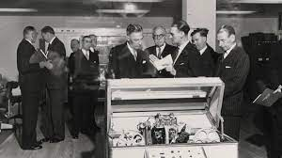
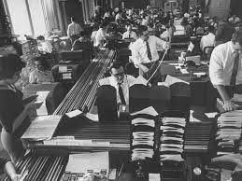
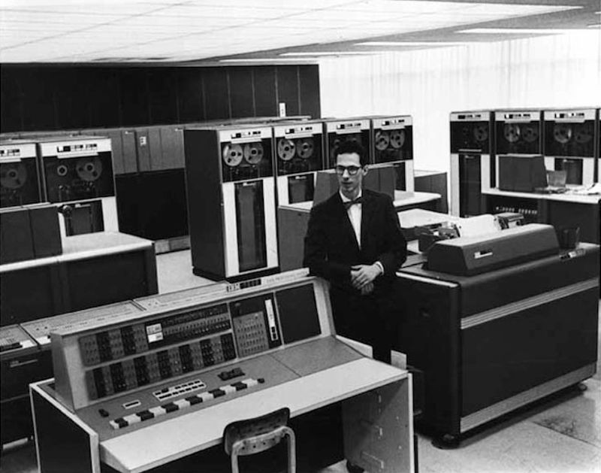
HOW BANKING WAS DONE IN THE PAST BEFORE ICT
Here are some highlights from the top-voted answer from Redditor 'xtremity‘
Cash was more important than it is today. It was what you got paid in. It wasn't as though your wages got automatically put into an account and you were forever going to the bank to make minor withdrawals as we tend to today from ATMs.
Since your home branch was so important, the staff tended to know its customers by face -- no banking by phone or machine in those days. So they had a pretty good sense of where your finances stood when you came in to make deposits. Since cash was so important in those days, and was what people got paid in, individual people tended to make deposits (including mortgage repayments) more often than withdrawals.

Slide 8
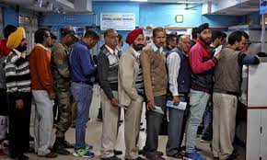
HOW BANKING WAS DONE IN THE PAST BEFORE ICT (CONT’D)
A big advance in portability was the check. This was essentially a withdrawal slip filled in and given to someone else so they could get the money, but rather than have to take it to your bank to get the money out, the recipient could deposit the withdrawal slip/check at their bank and the banks would do the paper shuffling for everyone.
A big advance in portability was the check. This was essentially a withdrawal slip filled in and given to someone else so they could get the money, but rather than have to take it to your bank to get the money out, the recipient could deposit the withdrawal slip/check at their bank and the banks would do the paper shuffling for everyone.

Slide 9
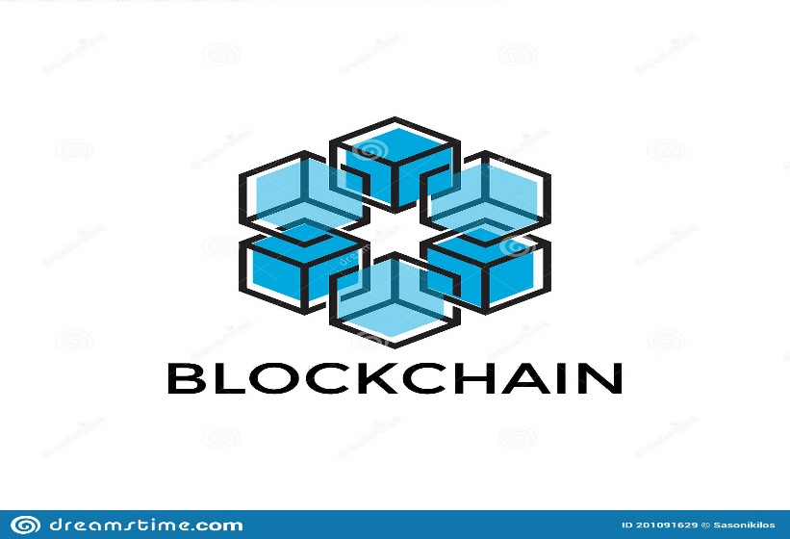

CURRENT TRENDS OF ICT ON BANKING AND FINANCE
DIGITAL ACCOUNT OPENING
PERSON-TO-PERSON (P2P)
HYBRID CLOUD
ROBOTIC PROCESS AUTOMATION (RPA)
BLOCKCHAIN

Slide 10
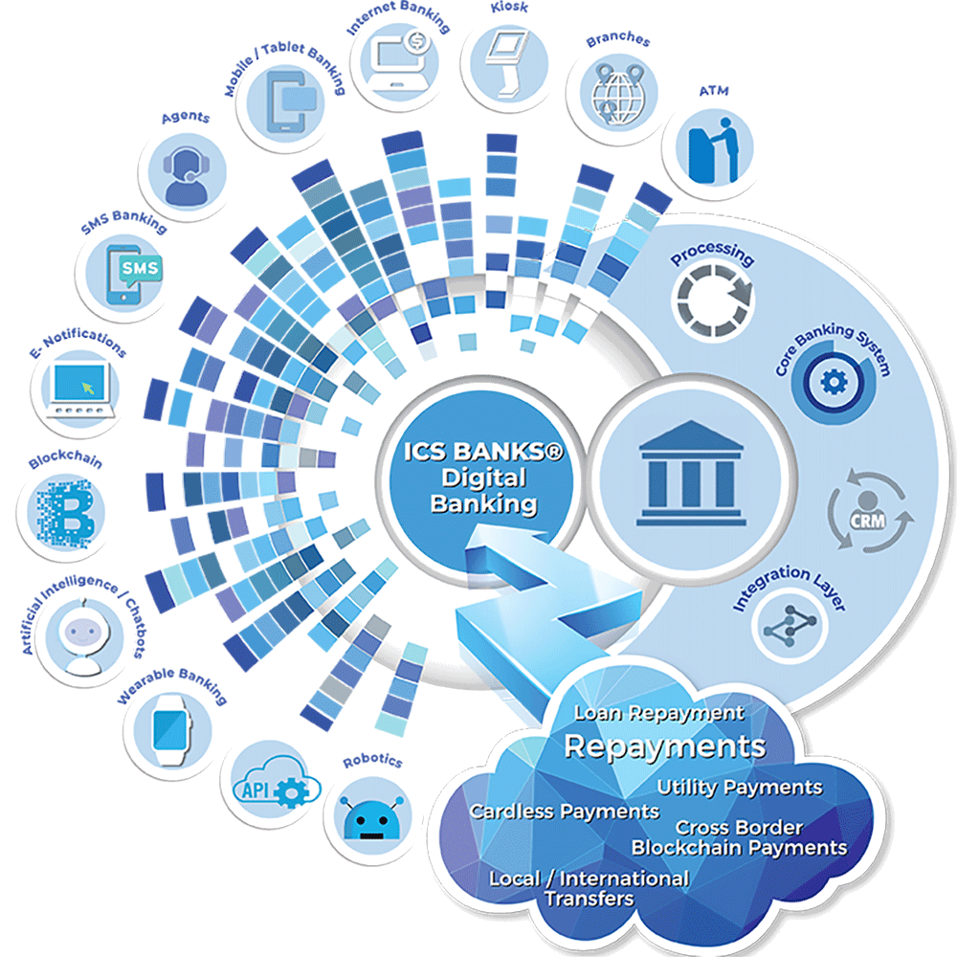
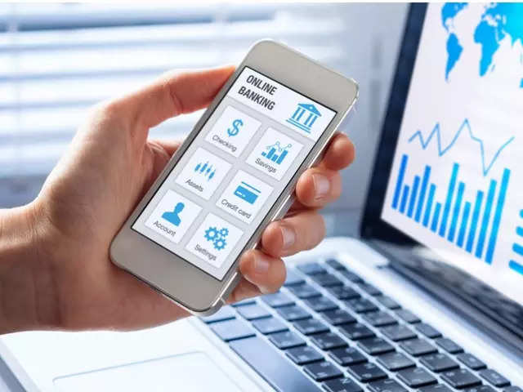
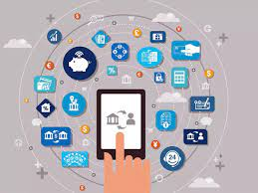
IMPACT OF ICT ON BANKING
POSITIVE IMPACT
Banking process is faster than before and more reliable. Maintenance and retrieval of documents and records have become much faster and easier.
Computerized banking also improves the core banking system. With CBS (core banking system) all branches have access to common centralized data and are interconnected.
With the innovation of MICR cheque processing system, the processing of cheques becomes more faster and efficient h than before.
USSD (Unstructured supplementary service data) was launched by Government, so people with no internet-connectivity too can access their bank accounts without visiting the branch.

Slide 11

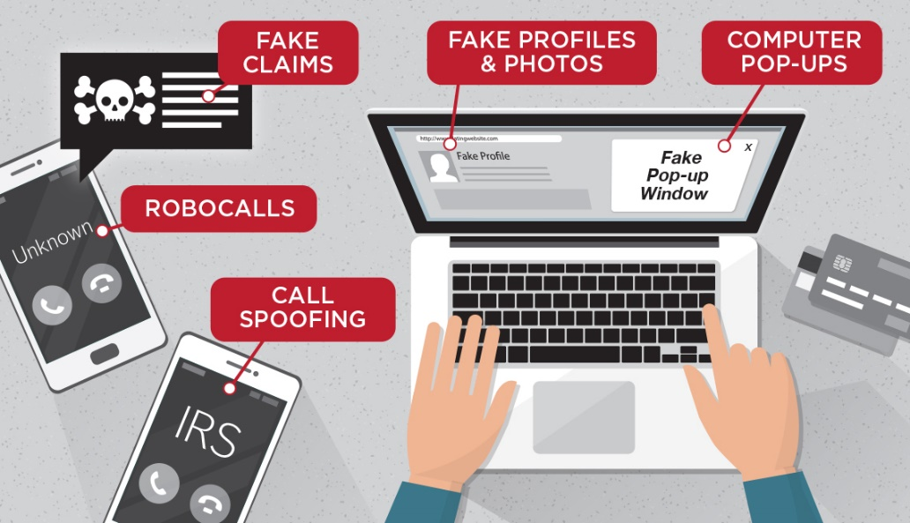
IMPACT OF ICT ON BANKING (CONT’D)
NEGATIVE IMPACT
The biggest negative impact of technology is loss of Jobs as automation has replaced number of jobs in banking sector.
Through technology comes the threat of Cyber Attack, a loophole in the system, millions of data can be lost in the blink of an eye.
These technologies consumes less time, it also sometimes makes people careless-which causes loss of personal details as happened last year in 2016,many debit cards details of big banks were compromised.

Slide 12


Slide 13


Slide 14


Slide 15
IMPORTANCE OF COMPUTER IN BANKING SECTOR
Information technology is the term which generally covers the use of electronic technology for the information needs of a business at all levels. It has made it possible for banks to:
Improve in service delivery with the availability of online, real-time transactions.
Funds transfer will be faster, more accurate and cheaper in charges.
Capacity to process large volume of transactions which will require lower administrative cost.
Reduction of cash transactions with long term prospects of minimal cash handling.

Slide 16
ADVANTAGES OF COMPUTER IN BANKING SECTOR
Electronic Banking
Banking anytime and anywhere
Telebanking:
Self-inquire facility
Remote Banking

Slide 17
DISADVANTAGES OF COMPUTERS IN BANKING SECTOR
Technology and service interruptions
Security and Identity Theft Concerns
Limitations on Deposits
Convenient but Not Always Faster
Lack of Personal Banker Relationship
A Limited Scope of Services

Slide 18
FUTURE TRENDS
Digital money
The future of money – will physical money disappear?
The rise of finance apps
Consumer expectations for more personalized, intelligent services

Slide 19
CONCLUSION
The impact of Information and Communications Technology in banking sector is enormous and has global impact. It has equally affected leading organizations all over the world. The effect is not only in the banking sector because virtually all sectors of human endeavor have experienced the revolution. Again, the speed of change is fast and in many years to come the impact will continue to cut across all areas of human endeavor going by the Research and Development (R&D) taking place all over the world presently. Change is a constant phenomenon and banking sector is not exempted. As such one needs to prepare himself or herself to such changes whenever the situation calls for it.
In conclusion Information and Communications Technology has great positive impact in the banking sector than the negative impact.

Slide 20


Slide 21
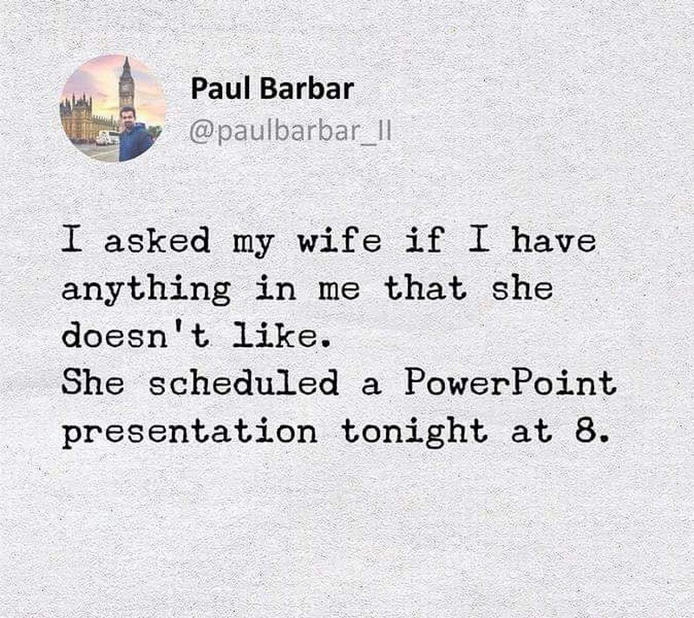

Slide 22


